Slide 1








HOME
SERVICE
ABOUT US
CONTACT US
SHIELD INSURANCE
Peace of Mind, Guaranteed
Our Happy Clients
4.9/ (2,456 Reviews)
Presented By Rahul G V
Created during the Virtual Data Analytics Internship by AtliQ Technologies, Codebasics.

Slide 2

Shield Insurance.
HOME
SERVICE
ABOUT US
CONTACT US
TABLE OF CONTENTS
Overview
Objectives
About Shield Insurance
Health insurance plan options
Business positioning in India
Policy overview by coverage & premium
Dataset duration
Data model
Sales modes
Dashboard walkthrough
Insights & Recommendations

Slide 3



Overview of Shield Insurance
Shield Insurance specializes in comprehensive health insurance solutions designed to protect individuals, families, and corporate clients from the financial impact of medical emergencies.
Our product portfolio includes everything from basic medical plans to high-value critical illness coverage, tailored to suit diverse health and financial needs.
With a commitment to trust and reliability, Shield Insurance has been serving individuals and businesses across all age groups, delivering peace of mind through a wide range of insurance solutions.

Slide 4

Objectives of Shield Insurance
To design and develop an interactive Power BI dashboard for meaningful and insightful data visualization.
To effectively present and explain the dashboard through a well-structured presentation video.
To gain a deeper understanding of customer behavior and preferences through data analysis.

Slide 5
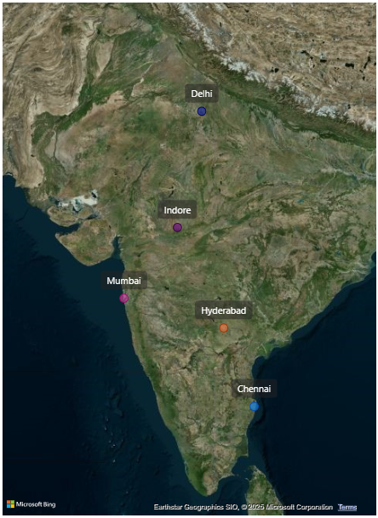
Health Insurance Plan Options
Business Positioning in India
Plan Type | Coverage | Targeted Audience
Basic Plan | ₹2 – ₹5 Lakhs | Individuals, Young Professionals
Family | ₹5 – ₹10 Lakhs | Nuclear & Small Families
Top-up | ₹10 – ₹25 Lakhs | Seniors, Health-conscious Families
Critical Illness | ₹25 Lakhs – ₹1 Crore | HNIs, Corporates, High-Risk Individuals

Slide 6
Policy Overview by Coverage & Premium
Dataset Duration
Policy | Coverage (₹) | Premium (₹) | Plan Type
POL4321HEL | 2,00,000 | 5,000 | Basic
POL4331HEL | 3,00,000 | 7,500 | Mid Tier
POL3309HEL | 5,00,000 | 12,000 | Family / Comprehensive
POL5319HEL | 7,50,000 | 16,700 | Extended
POL6303HEL | 10,00,000 | 21,500 | Higher Coverage
POL6093HEL | 15,00,000 | 31,700 | Top-up / Premium
POL9221HEL | 25,00,000 | 42,500 | High Net Worth
POL1048HEL | 50,00,000 | 76,500 | Critical Illness
POL2005HEL | 1,00,00,000 | 1,20,000 | Critical Illness (High)
2022
Nov
Dec
2023
Jan
Feb
Mar
Apr
Nov
2022
Dec
2022
Jan
2023
Feb
2023
Mar
2023
Apr
2023
Data Period: Nov 2022- Apr 2023

Slide 7
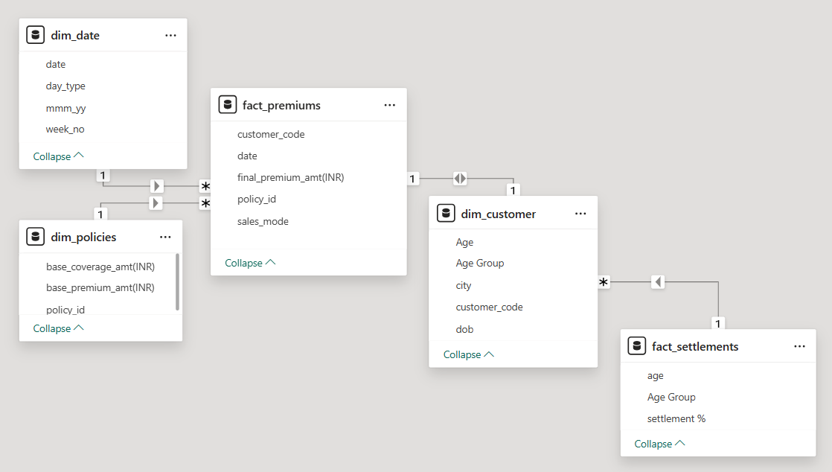
Data Model
Sales Mode
Offline Agent
Offline Direct
Online App
Online Website
A comprehensive dataset contains 3 Dimension Tables namely dim_Customer, dim_date, dim_ploicies
and 2 Fact tables namely fact_premiums, fact_settlements

Slide 8
Performance Analysis Key Insights
Revenue Surge
Customer Growth
Over 27,000 customers onboarded, showing positive brand traction.
High-Impact Month
March was the peak acquisition month with 7,081 users.
City-wise Performance
Delhi NCR, Mumbai, and Hyderabad led in both customer count and revenue.
Top Age Group Performance
The 31–50 age group drove the highest volume and revenue contribution.
Seasonal Dip
Shield Insurance earned ₹982.25M between Nov 2022–Apr 2023, marking a strong pilot launch.
Performance dip in Jan–Feb indicates seasonal or churn-related impact.

Slide 9
Sales mode Analysis Key Insights
Sales Mode Performance Overview:
Online Website leads in customer volume (40–45% share monthly).
Offline Agent mode yields the higher revenue per customer.
Monthly Trend Analysis:
Jan began the revenue rise, Feb saw the weakest performance across all channels, while Mar had the revenue peak.
Most Effective Channel:
The Offline Agent channel was the most successful, contributing ₹550.76M in revenue and handling ~15,000 customers.
March Revenue Performance
Offline Agent: ₹213.4M
Offline Direct & Online App modes show limited and stagnant contribution.
Online Website: ₹46M
Offline Direct: ₹29M
Online App: ₹2.54M

Slide 10
AGE Group Analysis Key Insights
Largest Customer Segment – Age 31–40
Over 10,500 customers, primarily purchasing through offline agents (6,100 policies), contributed to the highest expected settlements totaling ₹480M.
Strong Performer – Age 25–30
Respond well to tailored offers, peer referrals, and loyalty programs.
Senior Segment – Age 65+
Low engagement due to complexity; prefers agent-led, simplified onboarding and reassurance-focused communication.
Drop-Off Risk (Feb Dip)
Mid-quarter drop seen across all age groups in February, suggesting a need for timely customer engagement or retention efforts.

Slide 11
Strategic Recommendations
Address Mid-Quarter Drop-Offs
Analyze the Jan–Feb revenue dip to identify root causes (churn, policy expiry, or low marketing activity).
Maximize High-Value Age Segments
Double down on the 31–50 age group with targeted upselling and loyalty offers.
Create value-based bundles like family plans or milestone-based coverage (e.g., career, retirement).
Boost Younger Demographic Engagement (18–30)
Use gamified onboarding, influencer partnerships, and micro-payment options to appeal to the 18–24 segment.
Launch Q1 re-engagement and retention campaigns proactively each year.
Use predictive analytics to flag age groups or regions at risk of mid-quarter disengagement.
Strengthen agent-led onboarding for 65+ customers through simplified messaging and personal assistance.
Optimize Sales Channels
Continue scaling online mode with smarter nudges like “Top-up now” or limited-time offers.
Expand the agent network, especially in high-revenue cities, with incentives and CRM tools.
Re-activate branch and referral modes via hybrid onboarding and metro-based referral drives.
Strengthen Regional Strategy
In metro cities (Delhi, Mumbai, Hyderabad), offer localized campaigns and agent-targeted bonuses to sustain leadership.
In cities (Chennai, Indore), run incentive-based acquisition programs to unlock growth potential.
Leverage Data for Product Strategy
Align product offerings by age group and geography (e.g., low-value/high-turnover plans for younger users).
Monitor sales mode vs revenue behavior to fine-tune product placement and distribution strategy.
Deploy referral programs and digital loyalty campaigns for the 25–30 group to expand peer acquisition.

Slide 12



HOME
SERVICE
ABOUT US
CONTACT US
THANK YOU
Follow for more:
Mail Id: rahulramana1997@gmail.com
LinkedIn Profile: https://www.linkedin.com/in/rahul-gv/
Github Link: https://github.com/Rahul-G-V

